Slide 1
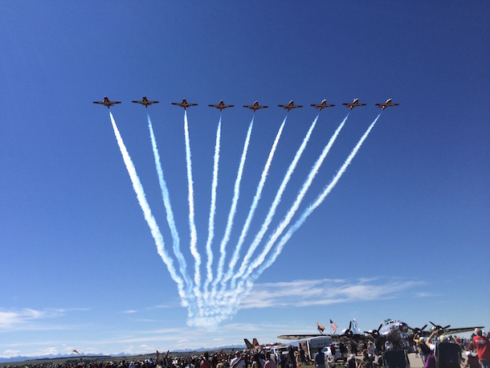
SPRINGBANK AIRPORT COMMUNITY NOISE CONSULTATIVE COMMITTEE June 21, 2016

Slide 2
Welcome & Introductions

Slide 3
Agenda
Airport movement statistics
Noise concern statistics
Noise monitoring
Jet departure study framework
Next steps
Community Representative Vacancy
New Business

Slide 4
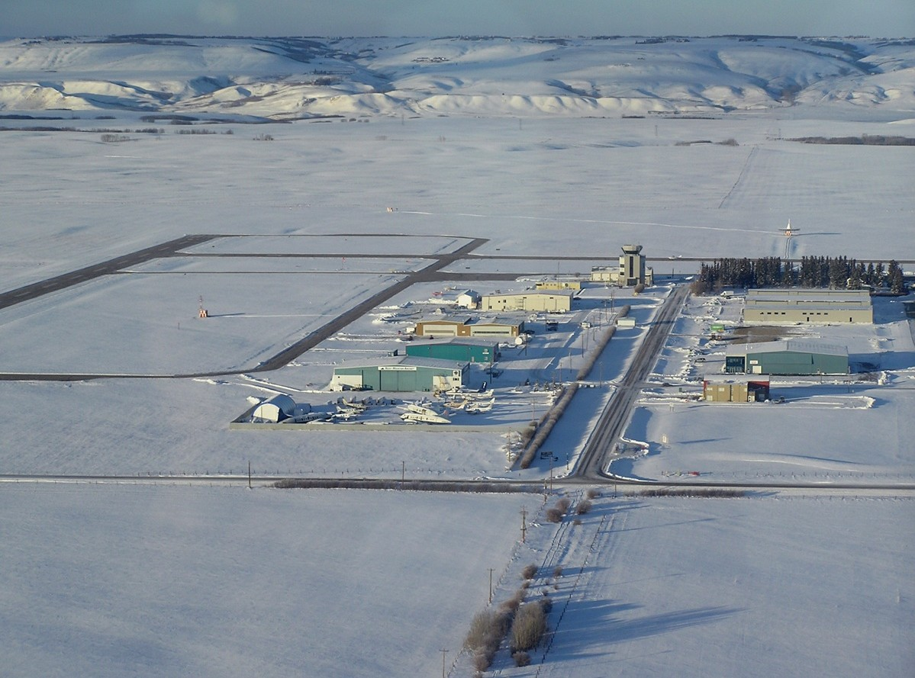
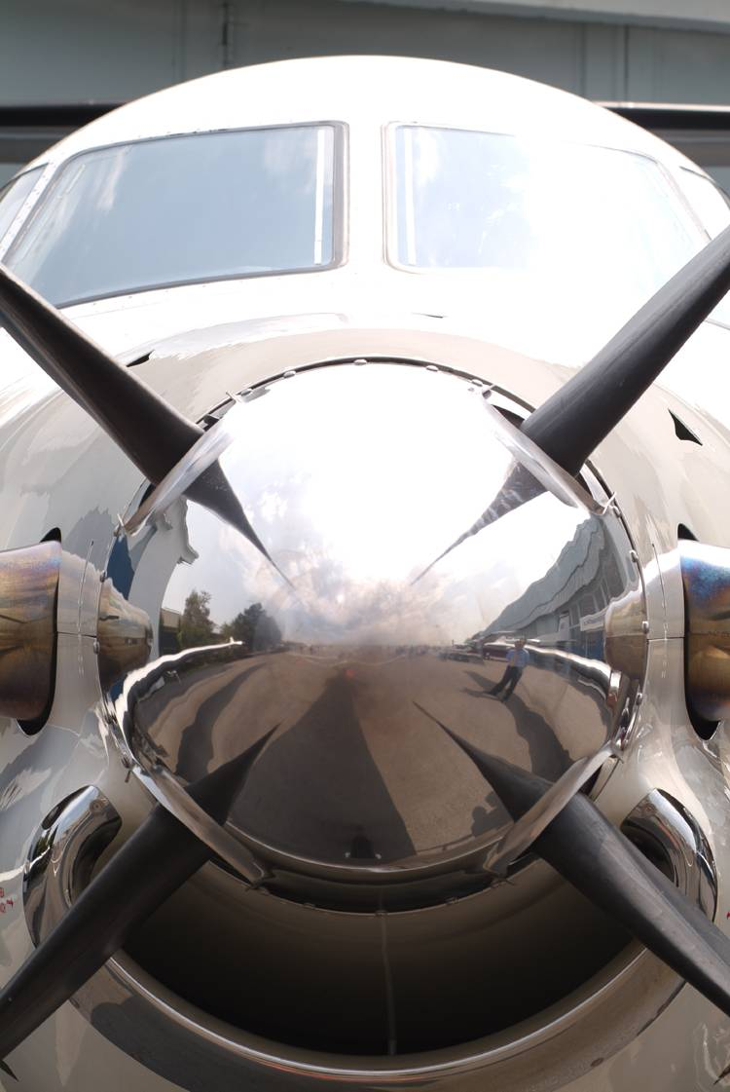
Operational Information

Slide 5
Annual Aircraft Movements

Slide 6
Monthly Aircraft Movements

Slide 7
Jet Night Traffic

Slide 8
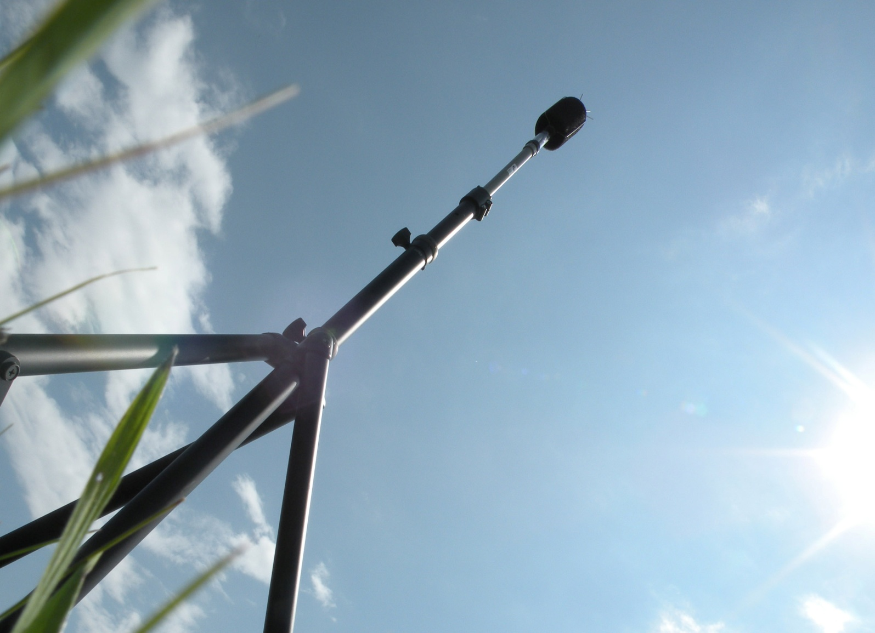
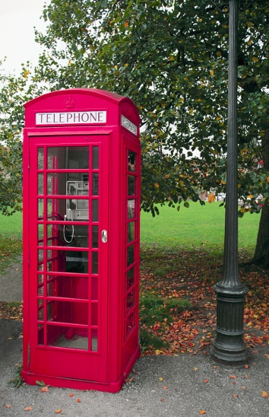
Noise Concern Information

Slide 9
Runway Usage

Slide 10
Monthly Noise Concerns

Slide 11
Day & Night Concerns

Slide 12
Hourly Noise Concerns

Slide 13
Concerns by Operation

Slide 14
Noise Monitoring
Jet departure subcommittee met early 2016 to discuss monitoring
Actual monitoring locations were picked, off end 1st - RWY 35 2nd - RWY 26
Monitoring device will be installed in the near future
Looking to achieve single event levels for specific aircraft in order to compare with virtual noise monitoring software.
If actual noise monitoring produces values similar to virtual noise monitoring software, virtual noise monitoring can begin.

Slide 15
Jet Departure Study Framework
We have undertaken a statistical analysis of movements of jets as they relate to all other traffic between the hours of 23:00 and 07:00
We have correlated the jet statistics after hours with the noise complaint statistics
We will undertake actual noise monitoring of single events and compare with virtual noise monitoring values, as well as compare these to events relating to existing non jet types
We will report back to the community once we have information to provide, hopefully by the fall of this year

Slide 16
Community Representative Vacancy
A member of the NCC has recently retired their seat on the committee
We are looking for community input with respect to the best way to fill that vacancy
We would suggest that the seat be open to anyone willing to represent the local area of their community within a specific radius of the airport
Open discussion on these points

Slide 17
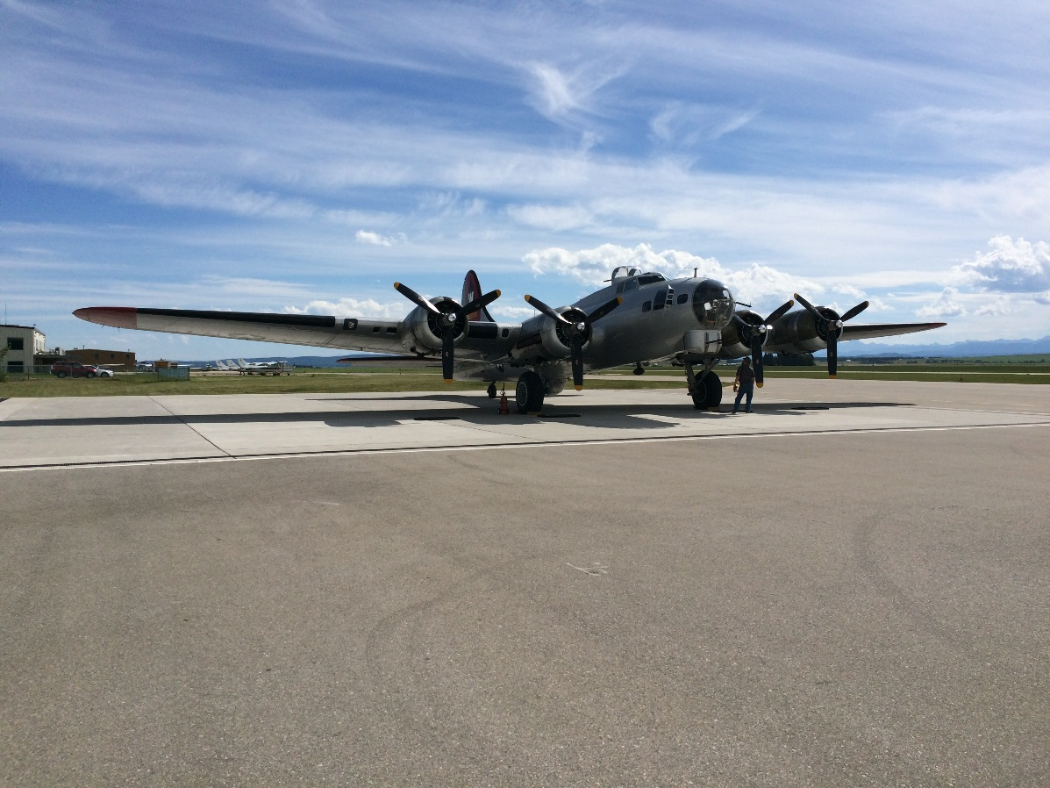
New Business
Experimental Aircraft Association B-17 tour.

Slide 18
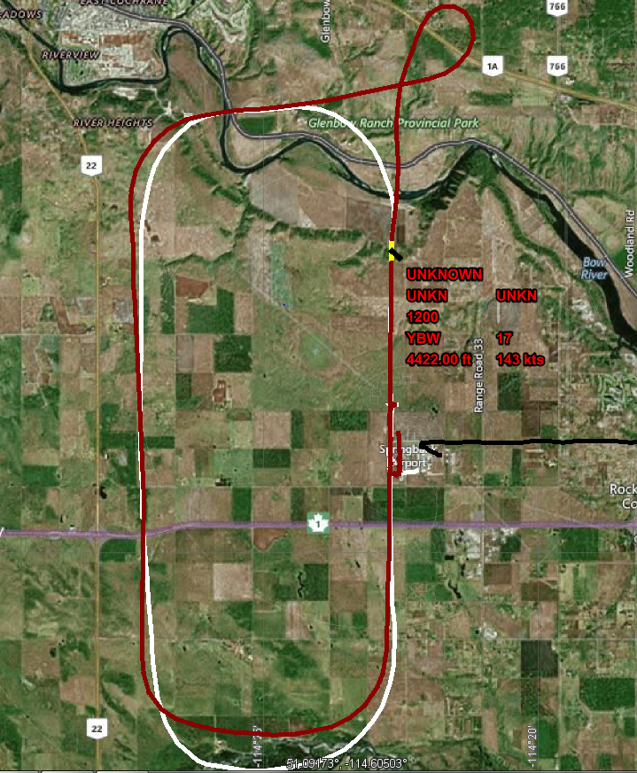
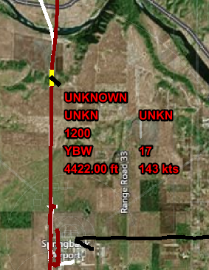
New Business
Explanation of complaint investigation process per June 20th circuits after hours.

Slide 19
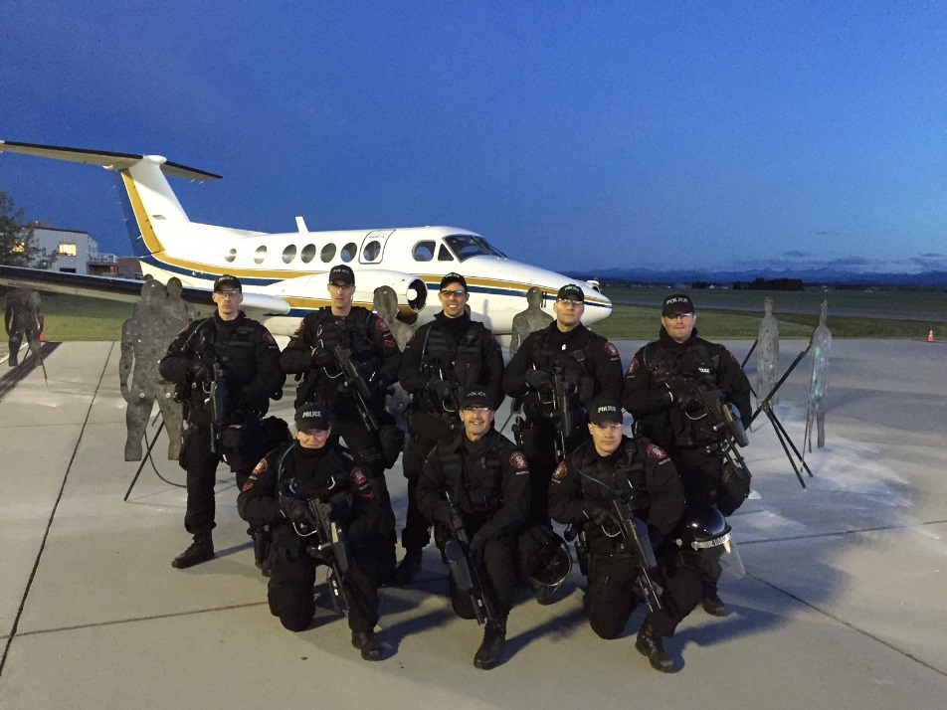
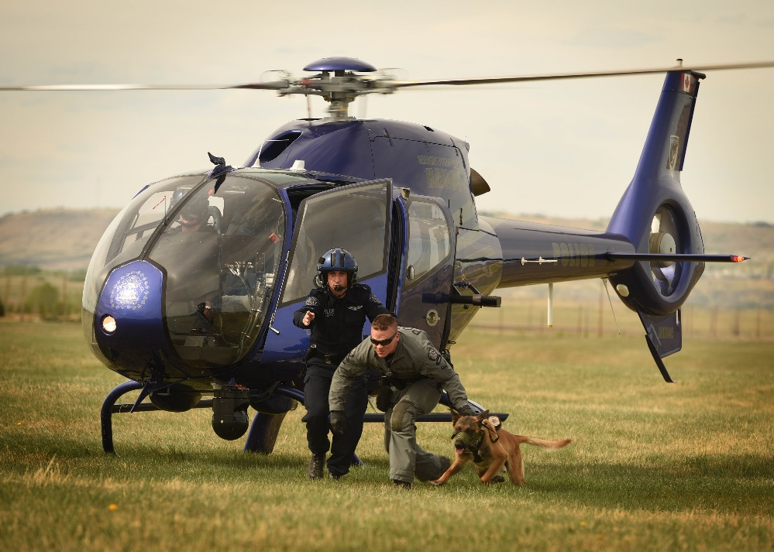
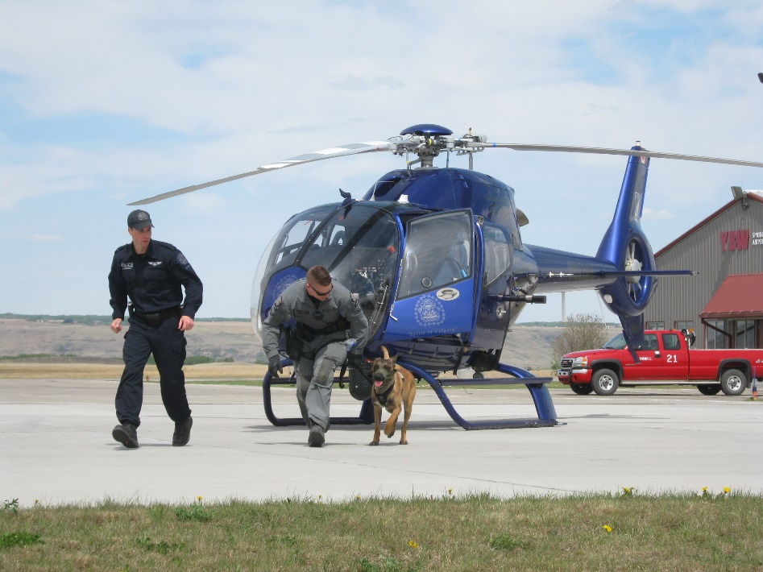
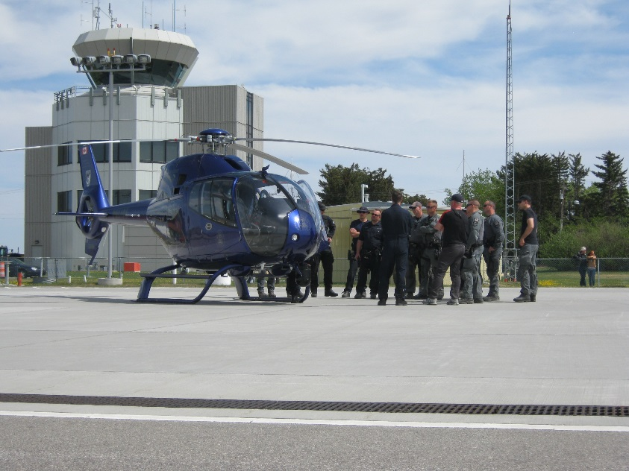
New Business
Calgary Police Service – 2 Training Opportunities provided by YBW

Slide 20
New Business
Community Engagement – Explain the new Community Engagement Department within the Authority, and advise that we will be part of the Old Tyme Fall Fair

Slide 21
Questions??

